Slide 1
Gilded
Age
Politics

Slide 2
The
"Politics of
Equilibrium"

Slide 3
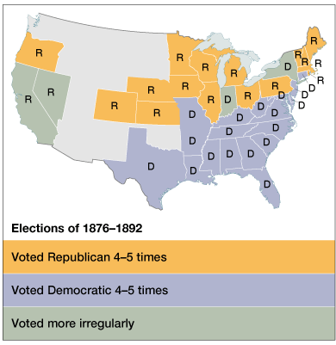
1. A Two-Party Stalemate

Slide 4
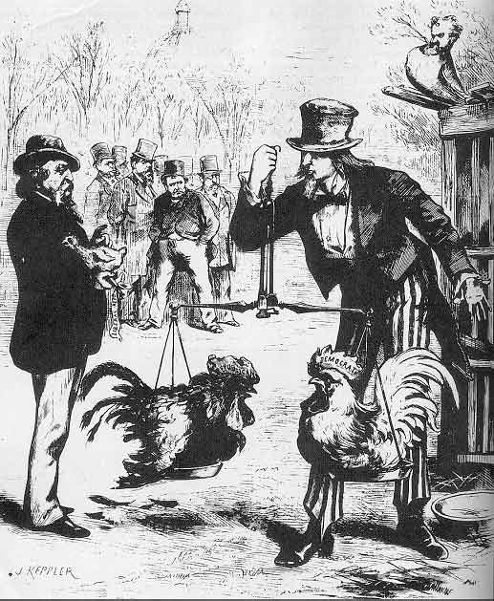
Two-Party “Balance”

Slide 5
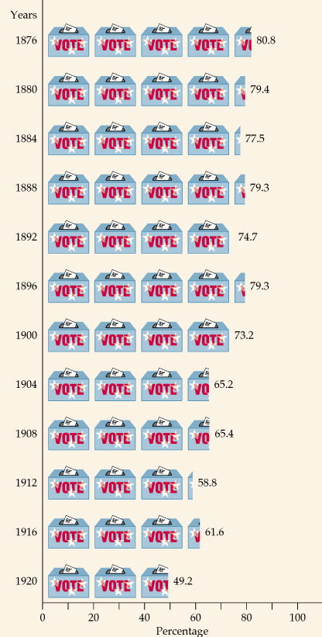
2. Intense
Voter Loyalty
to the
Two Major
Political Parties

Slide 6
3. Well-Defined Voting Blocs
Democratic
Bloc
Republican
Bloc
White southerners
(preservation of
white supremacy)
Catholics
Recent immigrants
(esp. Jews)
Urban working
poor (pro-labor)
Most farmers
Northern whites
(pro-business)
African Americans
Northern
Protestants
Old WASPs (support
for anti-immigrant
laws)
Most of the middle
class

Slide 7
4. Very Laissez Faire Federal Govt.
From 1870-1900 → Govt. did very
little domestically.
Main duties of the federal govt.:
  Deliver the mail.
  Maintain a national military.
  Collect taxes & tariffs.
  Conduct a foreign policy.
Exception → administer the annual
Civil War veterans’ pension.

Slide 8
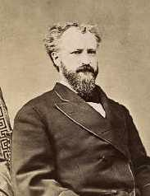
5. The Presidency as a Symbolic Office
Party bosses ruled.
Presidents should
avoid offending any
factions within their
own party.
The President just
doled out federal jobs.
  1865 → 53,000 people worked for the federal govt.
  1890 → 166,000 “ “ “ “ “ “
Senator Roscoe Conkling

Slide 9
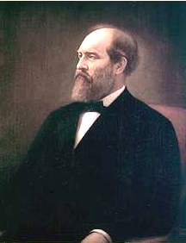
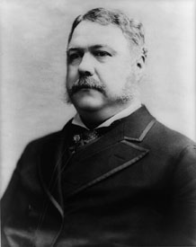
1880 Presidential Election: Republicans
Half Breeds
Stalwarts
Sen. James G. Blaine Sen. Roscoe Conkling
(Maine) (New York)
compromise
James A. Garfield Chester A. Arthur (VP)

Slide 10
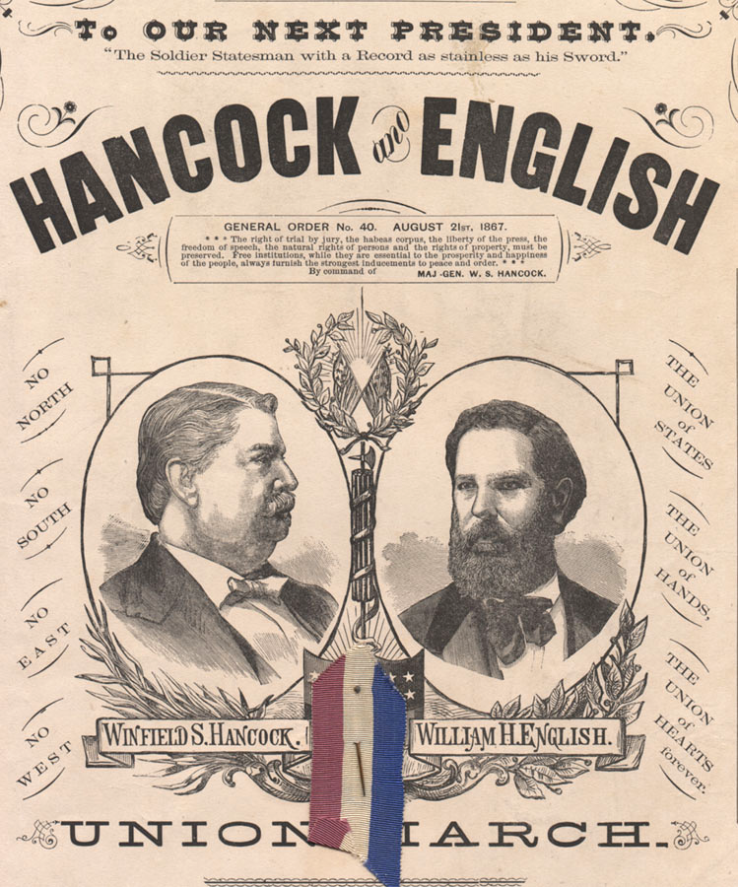
1880 Presidential Election: Democrats

Slide 11
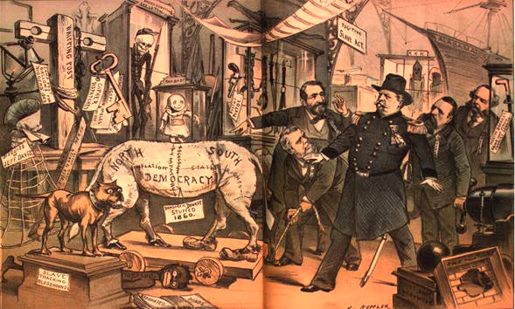
Inspecting the Democratic Curiosity Shop

Slide 12
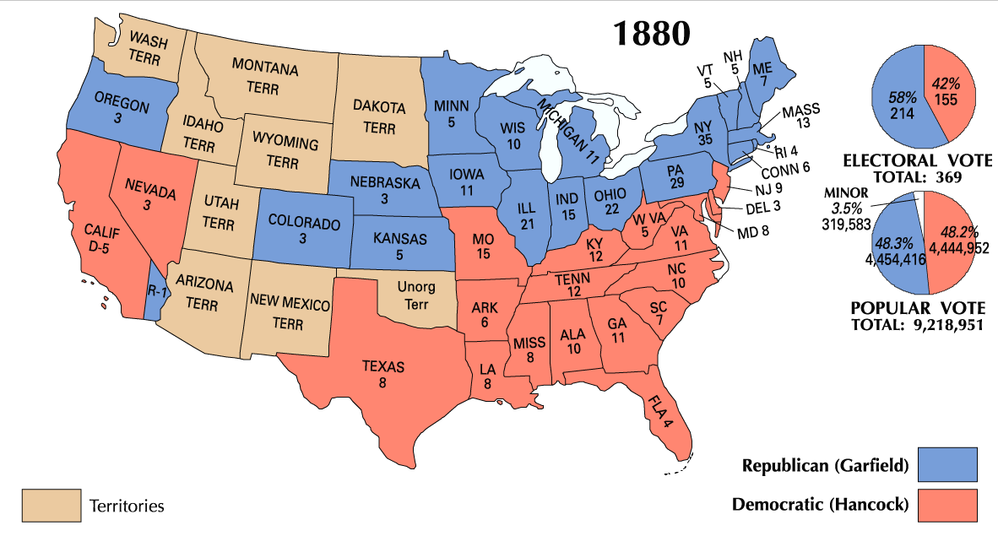
1880 Presidential Election

Slide 13
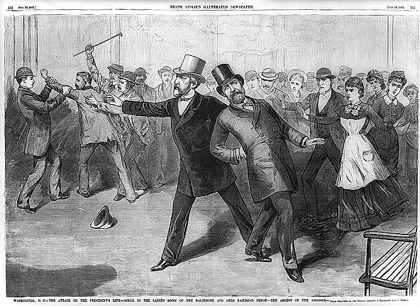
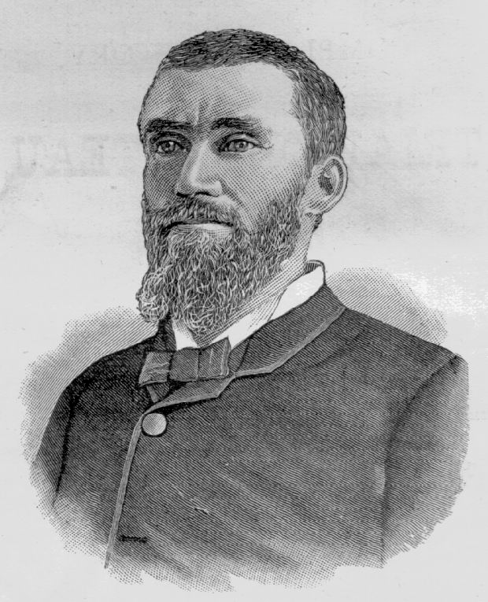
1881: Garfield Assassinated!
Charles Guiteau:
I Am a Stalwart, and Arthur is President now!

Slide 14
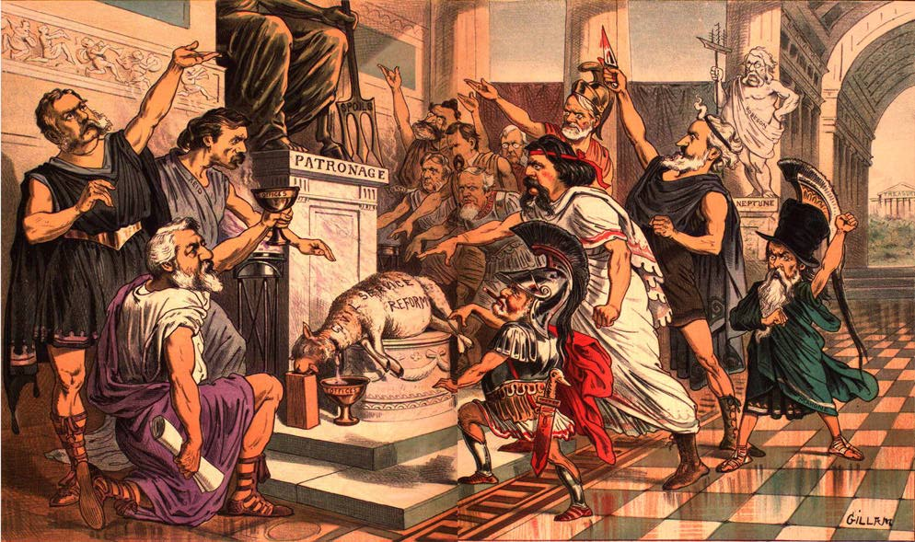
Chester A. Arthur:
The Fox in the Chicken Coop?

Slide 15
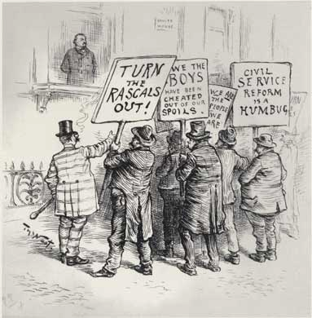
Pendleton Act (1883)
Civil Service Act.
The “Magna Carta” of
civil service reform.
1883 → 14,000 out of
117,000 federal govt.
jobs became civil
service exam positions.
1900 → 100,000 out of
200,000 civil service
federal govt. jobs.

Slide 16
Republican “Mugwumps”
Reformers who wouldn’t re-nominate
Chester A. Arthur.
Reform to them → create a disinterested, impartial govt. run by an educated elite like themselves.
Social Darwinists.
Laissez faire government to them:
  Favoritism & the spoils system seen as
  govt. intervention in society.
  Their target was political corruption,
  not social or economic reform!

Slide 17
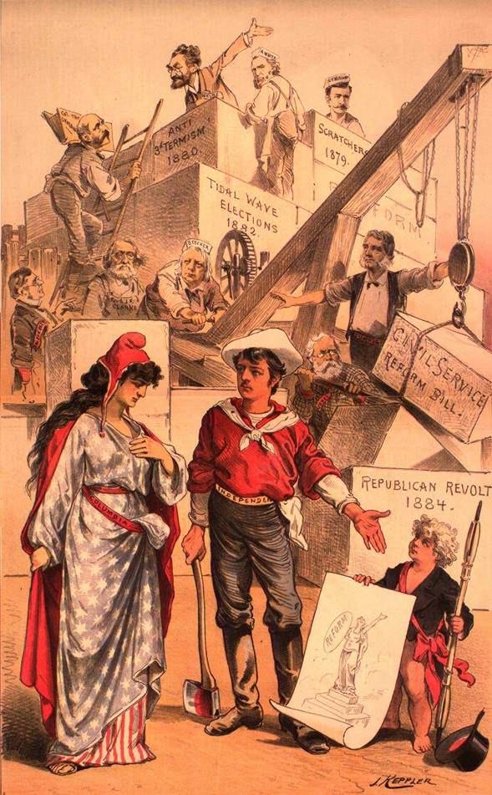
The
Mugwumps
Men may come and men may go, but the work of reform shall go on forever.
Will support
Cleveland in the
1884 election.

Slide 18
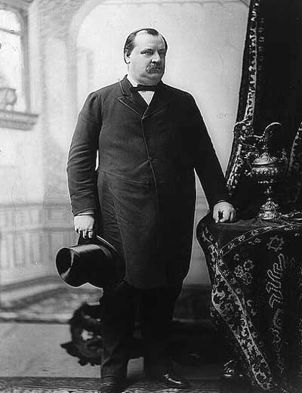
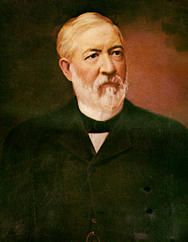
1884 Presidential Election
Grover Cleveland James Blaine
* (DEM) (REP)

Slide 19
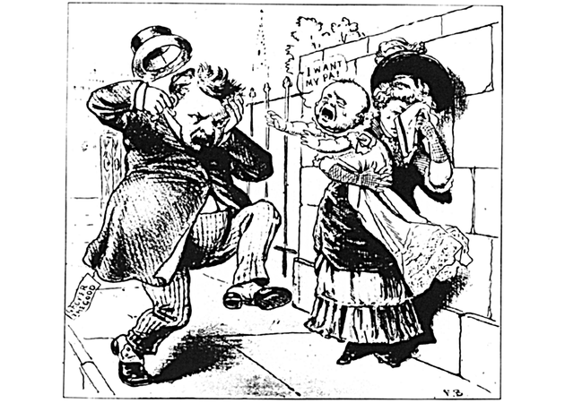
A Dirty Campaign
Ma, Ma…where’s my pa?
He’s going to the White House, ha… ha… ha…!

Slide 20
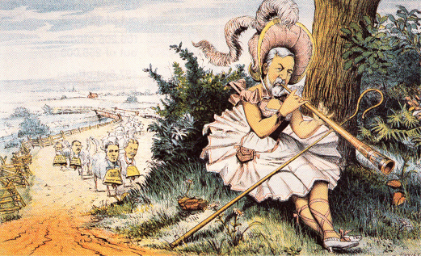
Little Lost Mugwump
Blaine in 1884

Slide 21
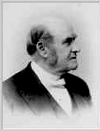
Rum, Romanism & Rebellion!
Led a delegation of
ministers to Blaine in
NYC.
Reference to the
Democratic Party.
Blaine was slow to
repudiate the remark.
Narrow victory for
Cleveland [he wins NY
by only 1149 votes!].
Dr. Samuel Burchard

Slide 22
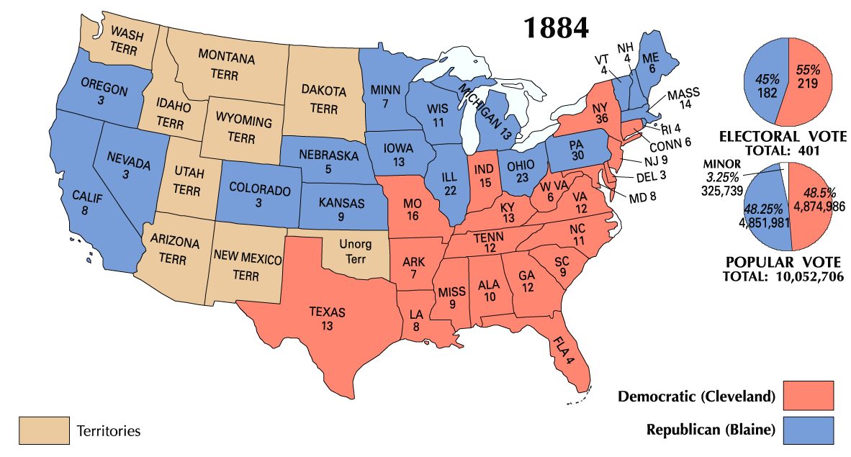
1884 Presidential Election

Slide 23
Cleveland’s First Term
The “Veto Governor” from New York.
First Democratic elected since 1856.
A public office is a public trust!
His laissez-faire presidency:
  Opposed bills to assist the poor as
  well as the rich.
  Vetoed over 200 special pension bills
  for Civil War veterans!

Slide 24
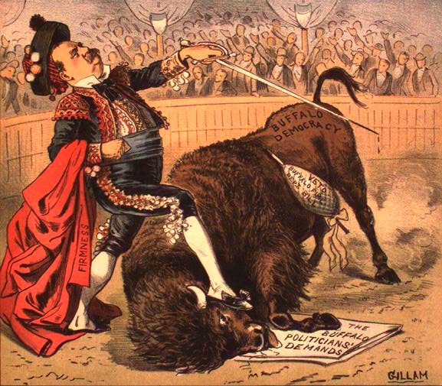
Bravo, Señor Clevelando!

Slide 25
The Tariff Issue
After the Civil War, Congress raised
tariffs to protect new US industries.
Big business wanted to continue this;
consumers did not.
1885 → tariffs earned the US $100 mil.
in surplus!
Mugwumps opposed it → WHY???
President Cleveland’s view on tariffs????
Tariffs became a major issue in the 1888
presidential election.

Slide 26
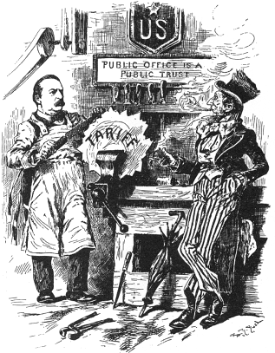
Filing the Rough Edges
Tariff of 1888

Slide 27
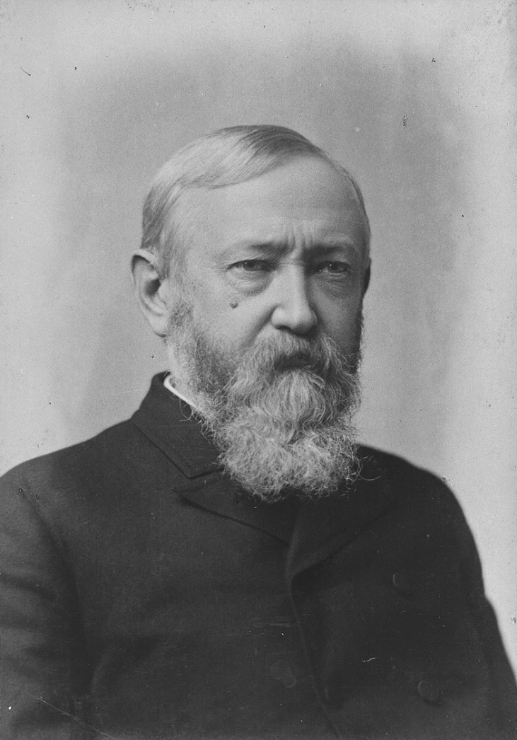
1888 Presidential Election
Grover Cleveland Benjamin Harrison
(DEM) * (REP)

Slide 28
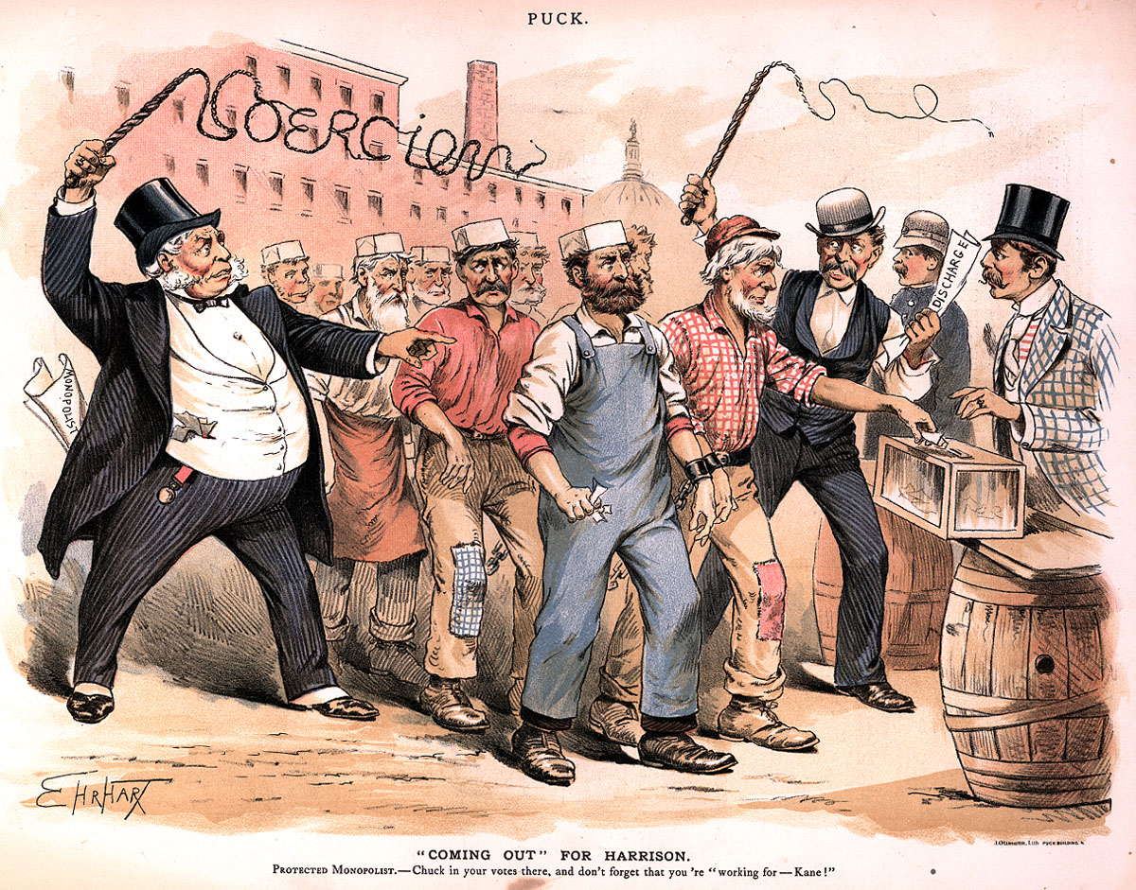
Coming Out for Harrison

Slide 29
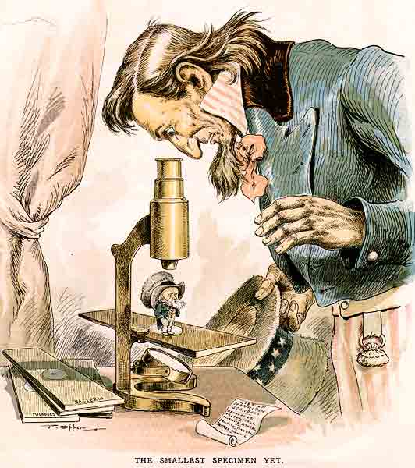
The Smallest Specimen Yet

Slide 30
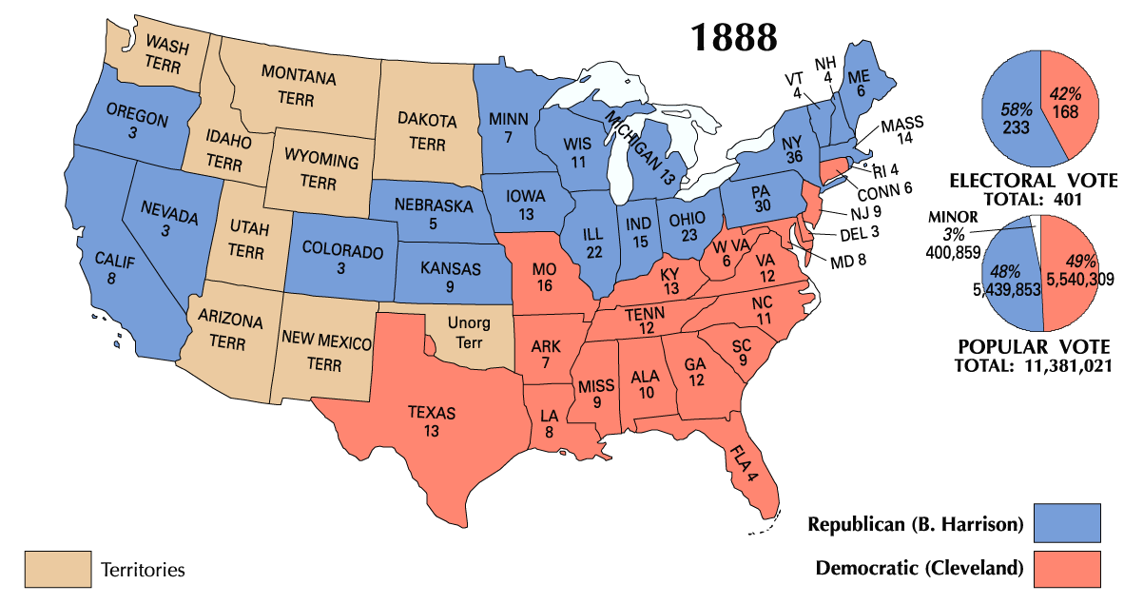
1888 Presidential Election

Slide 31
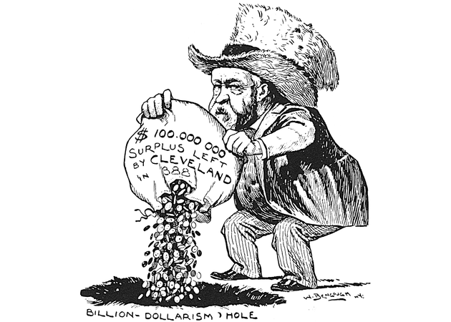
Disposing the Surplus

Slide 32
Changing Public Opinion
Americans wanted the federal govt. to deal
with growing soc. & eco. problems & to curb
the power of the trusts:
  Interstate Commerce Act – 1887
  Sherman Antitrust Act – 1890
  McKinley Tariff – 1890
    Based on the theory that prosperity
    flowed directly from protectionism.
    Increased already high rates another 4%!
  Rep. Party suffered big losses in 1890 (even
  McKinley lost his House seat!).

Slide 33
1892 Presidential Election
Grover Cleveland Benjamin Harrison
again! * (DEM) (REP)

Slide 34
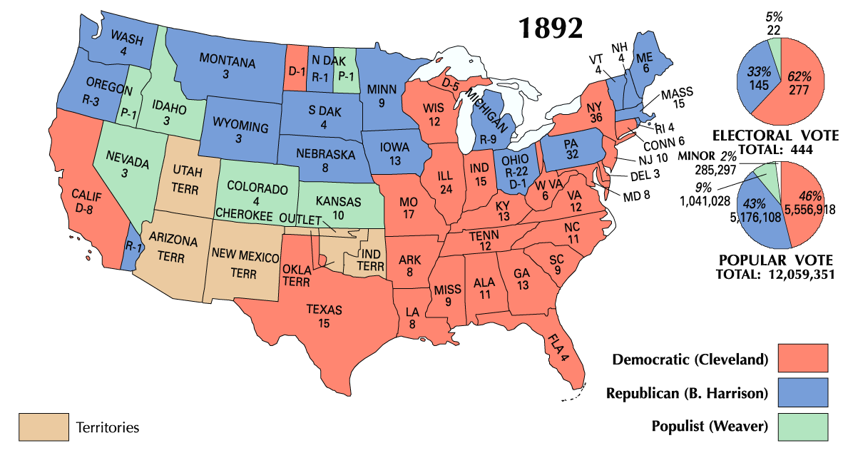
1892 Presidential Election

Slide 35
Cleveland Loses Support Fast!
The only President to serve two non-
consecutive terms.
Blamed for the 1893 Panic.
Defended the gold standard.
Used federal troops in the 1894
Pullman strike.
Refused to sign the Wilson-Gorman
Tariff of 1894.
Repealed the Sherman Silver Purchase Act.

